Slide 1


AIR QUALITY FORECASTING - Birmingham USA
Developed by: Fenglin Yin, Frederick Chan, Hannah Ying
June 2022

Slide 2
Agenda
Problem Definition Gathering Information Exploratory Analysis Model Choice Fit The Model Model Use and Backtesting

Slide 3

Problem Definition
PM 2.5 forecasting
Problem definition: how PM2.5 changed in 2021
The life expectancy of children born today will be shortened by 20 months on average
Bad air quality can have a negative impact on human lifespan (Pope et al., 2009).
At the same time, PM2.5 is an important part of air quality indicators. He describes particles smaller than 2.5 microns in diameter. Excessive PM2.5 may damage people's respiratory system (Xing et al., 2016).
This is necessary to reduce negative impact of air quality on people by forecasting PM2.5.

Slide 4
Agenda
Problem Definition Gathering Information Exploratory Analysis Model Choice Fit The Model Model Use and Backtesting

Slide 5
Gathering Information
Data Source:
All data are collected from ‘United States Environmental Protection Agency’
The Environmental Protection Agency (EPA) is an independent executive agency of the United States federal government tasked with environmental protection matters.
4 types of data: PM2.5, PM10, CO, SO
Each type of data contains 6 datasets and all air quality records from 2016 – 2021
Overall, there are 24 datasets contain all air quality records from 2016 - 2021

Slide 6
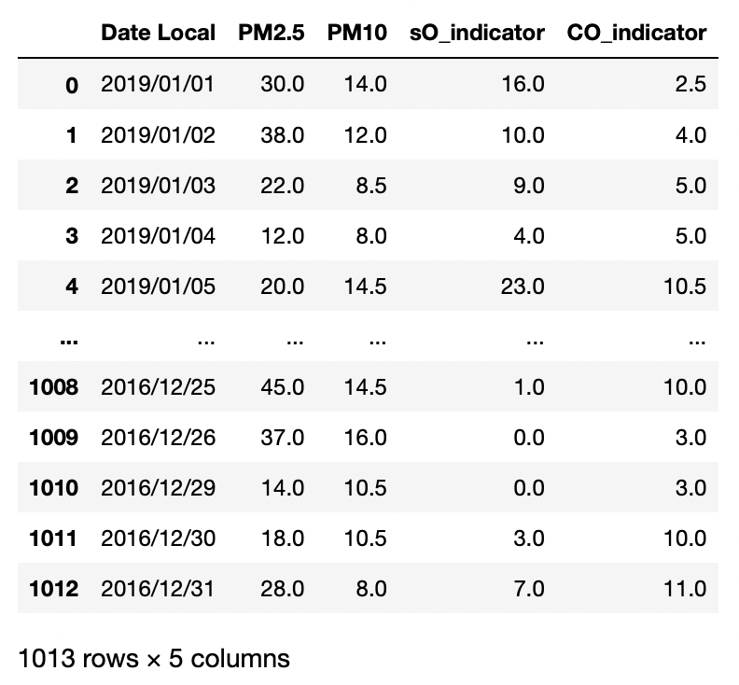
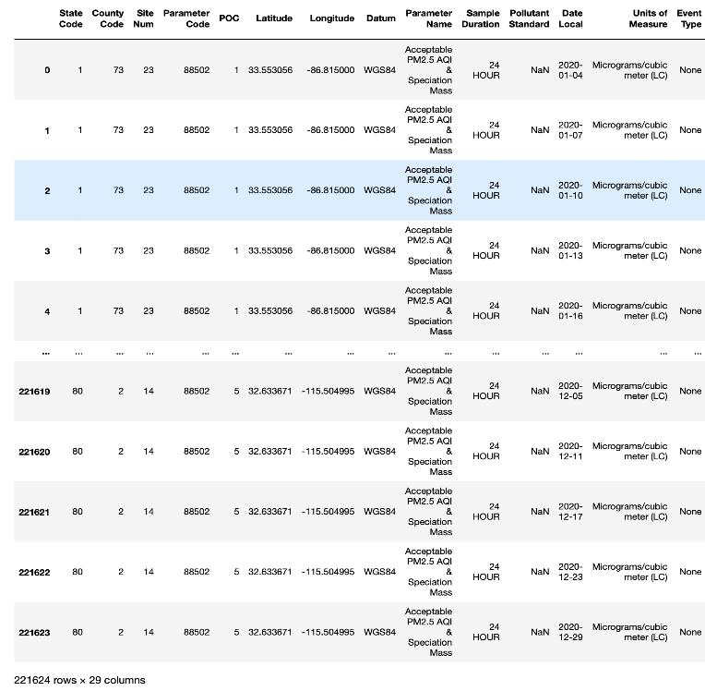
Data Processing methodology
Data Import
Data Cleaning
Data Integration
221624 rows × 29 columns
for one dataset
1013 rows × 5 columns

Slide 7
Agenda
Problem Definition Gathering Information Exploratory Analysis Model Choice Fit The Model Model Use and Backtesting

Slide 8
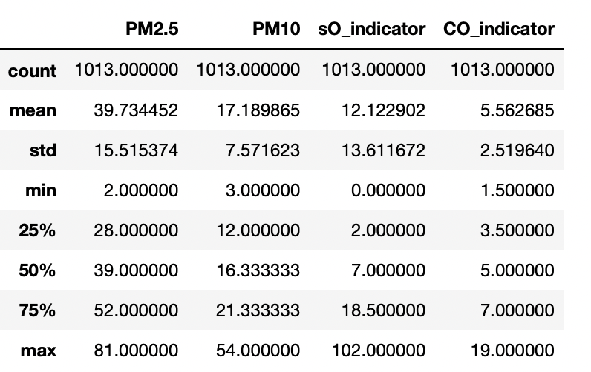
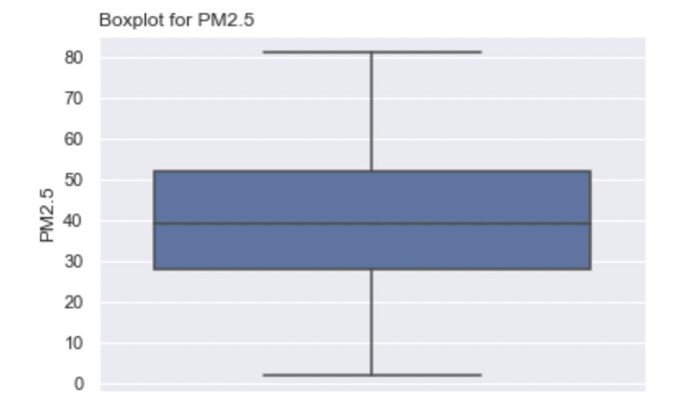
Exploratory Analysis
8

Slide 9
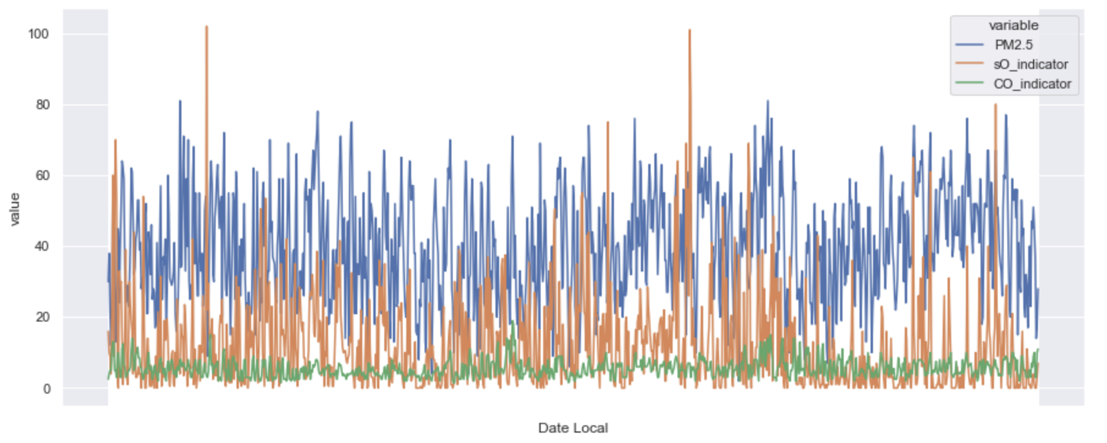
Exploratory Analysis
9

Slide 10
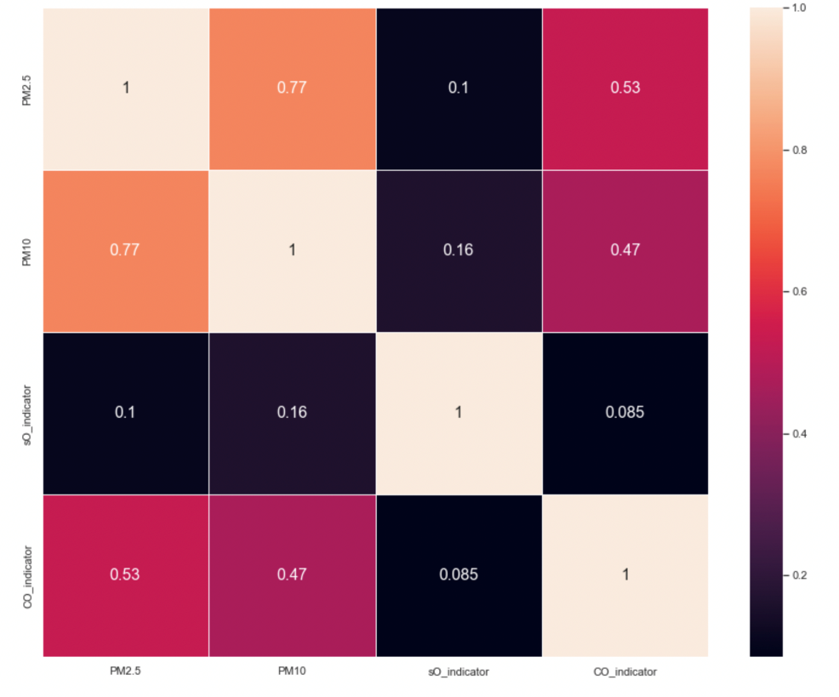
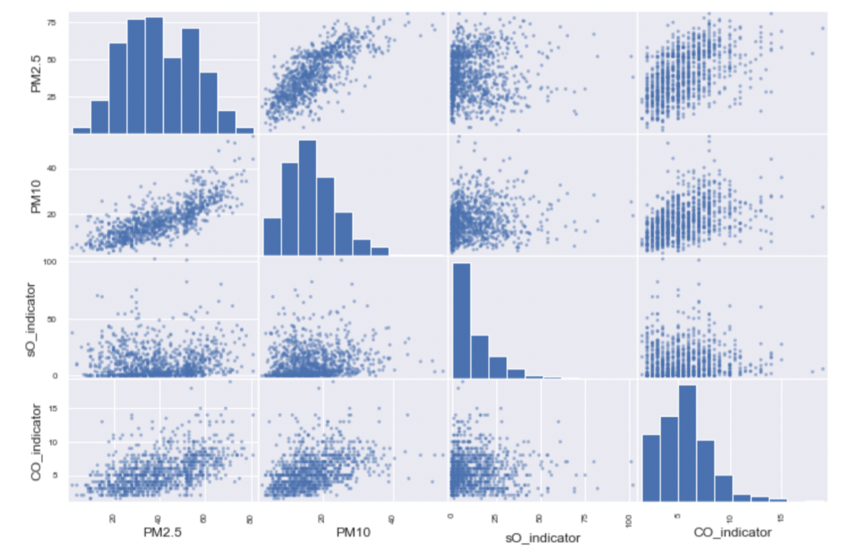
Exploratory Analysis
10

Slide 11
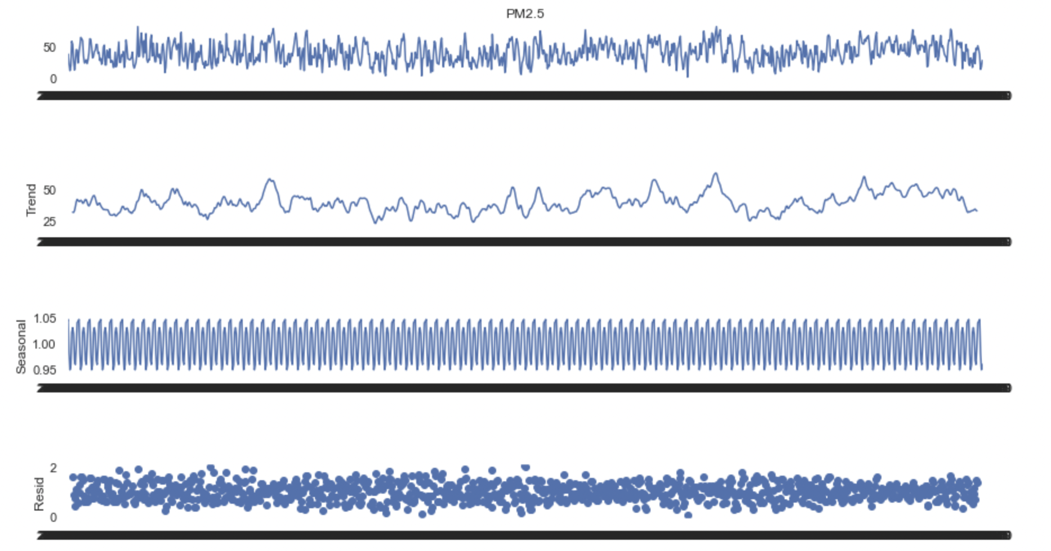
Exploratory Analysis
11

Slide 12
Agenda
Problem Definition Gathering Information Exploratory Analysis Model Choice Fit The Model Model Use and Backtesting

Slide 13
Model Choice
ARIMA Model & Linear Regression
ARIMA model is chosen for forecasting
ARIMA: Make forecasts based only on the past values of the forecast variable. The model assumes that future values of a variable linearly depend on its past values It includes also other independent (predictor) variables.
Multiple linear regression: Estimate the relationship between two or more independent variables and one dependent variable

Slide 14
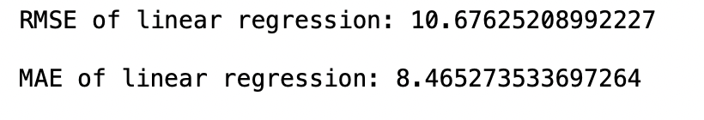
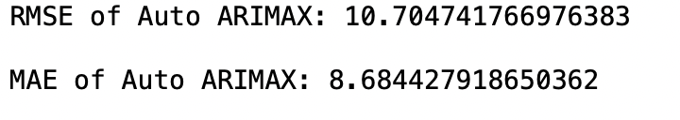
Model Choice
ARIMA Model & Linear Regression
Multiple Linear Regression
ARIMA

Slide 15
Agenda
Problem Definition Gathering Information Exploratory Analysis Model Choice Fit The Model Model Use and Backtesting

Slide 16
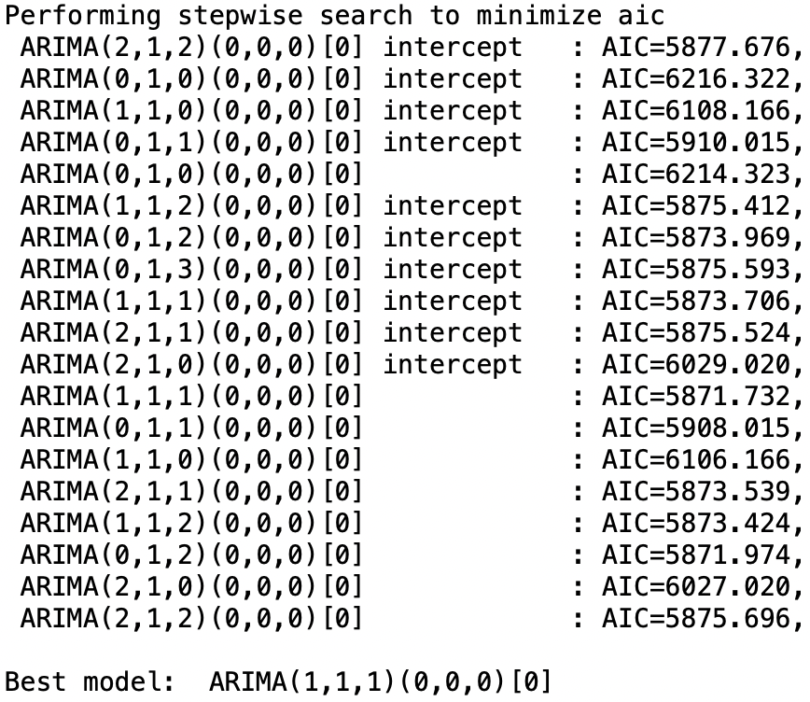
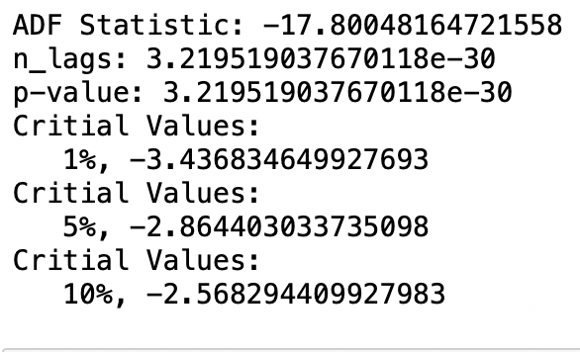
Fit Model
ADF Testing
Data Split
Train Model
Augmented Dickey–Fuller test
8/2 splitting
Ensure the data is stationary

Slide 17
Fit Model
ADF Testing
Used ADF test for stationary test.
Null Hypothesis (H0): dataset is not stationary.
if p-value lower than 0.05, then H0 rejected and the dataset is stationary
Alternate Hypothesis (H1): dataset is stationary.
p-value > 0.05: Fail to reject the null hypothesis (H0),
the data has a unit root and is non-stationary.
p-value <= 0.05: Reject the null hypothesis (H0),
the data does not have a unit root and is stationary.

Slide 18
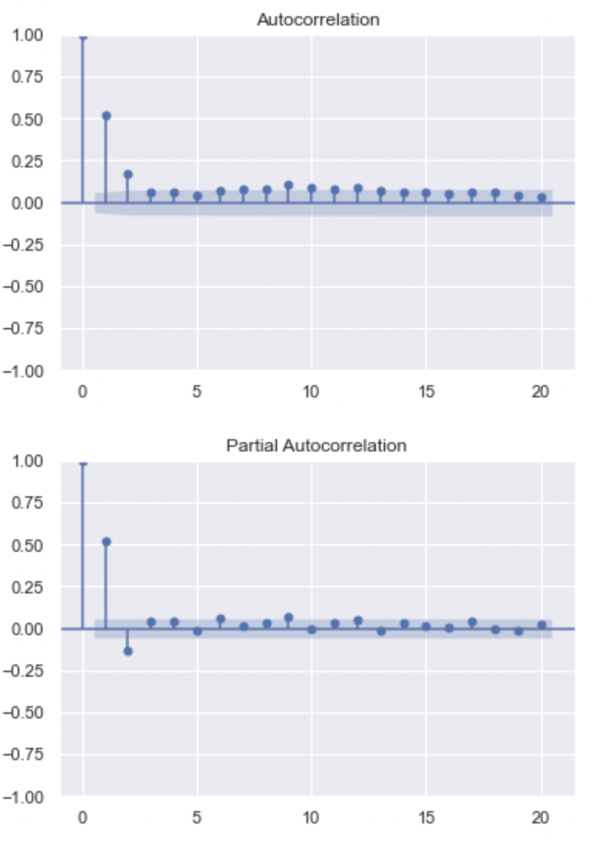
Fit Model
Train Model

Slide 19
Agenda
Problem Definition Gathering Information Exploratory Analysis Model Choice Fit The Model Model Use and Backtesting

Slide 20
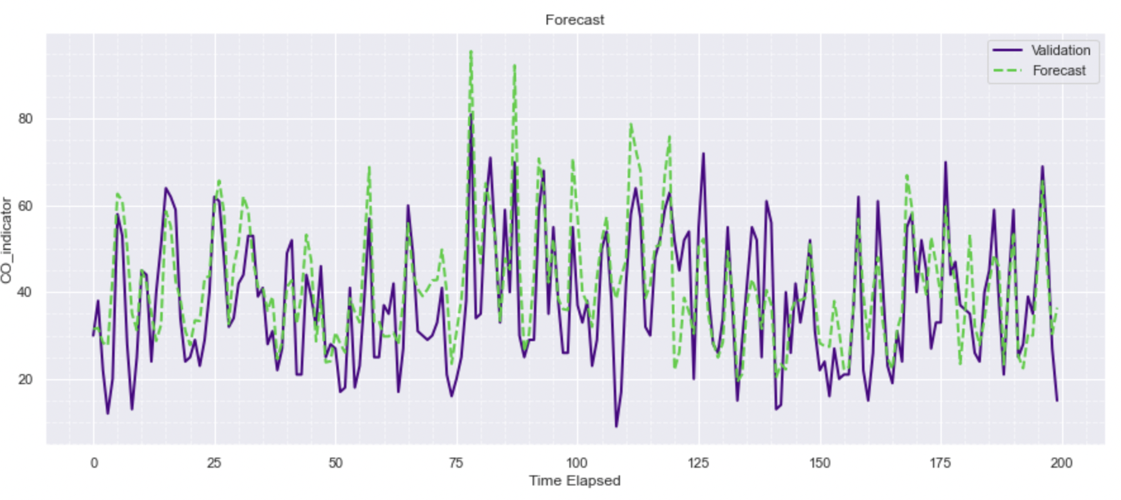
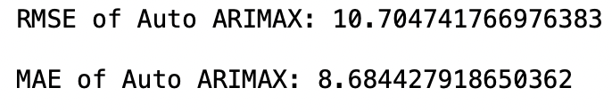
Model use and Backtesting
20

Slide 21
Reflection
Improvement Areas:
The result is good but still can be improve:
Take COVID impacts into consideration
Searching more data. Transportation data, such as number of cars on streets may help us to improve accuracy (Ejohwomu et al., 2022)
.

Slide 22
Reference list
Pope III, C. A., Ezzati, M., & Dockery, D. W. (2009). Fine-particulate air pollution and life expectancy in the United States. New England Journal of Medicine, 360(4), 376-386. Xing, Y. F., Xu, Y. H., Shi, M. H., & Lian, Y. X. (2016). The impact of PM2. 5 on the human respiratory system. Journal of thoracic disease, 8(1), E69. Khashei, M., Bijari, M., & Hejazi, S. R. (2012). Combining seasonal ARIMA models with computational intelligence techniques for time series forecasting. Soft computing, 16(6), 1091-1105. Ejohwomu, O. A., Shamsideen Oshodi, O., Oladokun, M., Bukoye, O. T., Emekwuru, N., Sotunbo, A., & Adenuga, O. (2022). Modelling and Forecasting Temporal PM2. 5 Concentration Using Ensemble Machine Learning Methods. Buildings, 12(1), 46.
Notes:
Die Programm auf einen Blick.
Kurze Vorstellung anhand von Beispielen:
z.B.: Studiengang in max. 1-2 Sätzen zusammenfassen
Ausführliche Infos gibt es in den Studiengangspräsentationen (darauf verweisen)

Slide 23

Thank you for your attention!

